Slide 1
WhatsApp: Analysis of algorithms implemented for Text data compression
By:
Anish Raj Hota:RA2211028010119
Amitesh Rawal:RA2211028010080
Section:R1

Slide 2
Table of contents
Introduction and Objective
DEFLATE Algorithm
Lz77 algorithm
Huffman coding
Visual Representation Demonstration
Conclusion

Slide 3
INTRODUCTION
BACKGROUND: WhatsApp is a widely used instant messaging platform owned by Meta Platforms, Inc. It serves billions of users worldwide. To provide users with a seamless messaging experience, WhatsApp relies on an intricate network of data structures and algorithms.
OBJECTIVES: This project aims to explore the constituent algorithms of DEFLATE algorithm used in WhatsApp for data compression, shedding light on the techniques employed to handle text data i.e. messages.

Slide 4
DEFLATE Algorithm
The DEFLATE algorithm is a lossless data compression algorithm used to reduce the size of data without losing any information. It combines two primary techniques: LZ77 and Huffman coding. Here's a brief overview of each component:
LZ77: The LZ77 algorithm is a sliding window compression technique. It works by replacing repeated occurrences of data within a sliding window with references to previous occurrences.
Huffman Coding: Huffman coding is a variable-length prefix coding technique used for lossless data compression. It assigns shorter codes to more frequently occurring symbols and longer codes to less frequent symbols.

Slide 5
Lz77 ALGORITHM
This component of the DEFLATE algorithm plays a crucial role in reducing redundancy within the data.
It achieves this by identifying repeated sequences of characters or symbols within a sliding window of previously encountered data.
Instead of storing each instance of a repeated sequence, LZ77 represents these occurrences as pointers or references to their earlier appearances.
By referencing existing data rather than storing duplicate information, LZ77 effectively reduces the overall size of the data stream. This compression technique is fundamental to DEFLATE's ability to efficiently compress data.

Slide 6
HUFFMAN CODING
Following the LZ77 compression step, Huffman coding aims to further minimize the size of the compressed data by assigning shorter codewords to frequently occurring symbols and longer codewords to less common ones.
This process involves constructing a Huffman tree based on the frequency of symbols in the data stream. Shorter codes are assigned to symbols with higher probabilities of occurrence, ensuring that the most common sequences are represented with the fewest bits.
By optimizing the encoding of symbols in this manner, Huffman coding enhances the overall compression achieved by DEFLATE. It efficiently encodes the compressed data stream, enabling more compact representation while preserving the original information content.

Slide 7
RESPECTIVE TIME COMPLEXITY
Lz77: The time complexity of the Lz77 algorithm for an inout string of n characters is O(n) since the algorithm linearly slides over the input to compress it.
Huffman algorithm: The time complexity of the Huffman algorithm is O(nlogn). Using a heap to store the weight of each tree, each iteration requires O(logn) time to determine the cheapest weight and insert the new weight. There are O(n) iterations, one for each item.

Slide 8
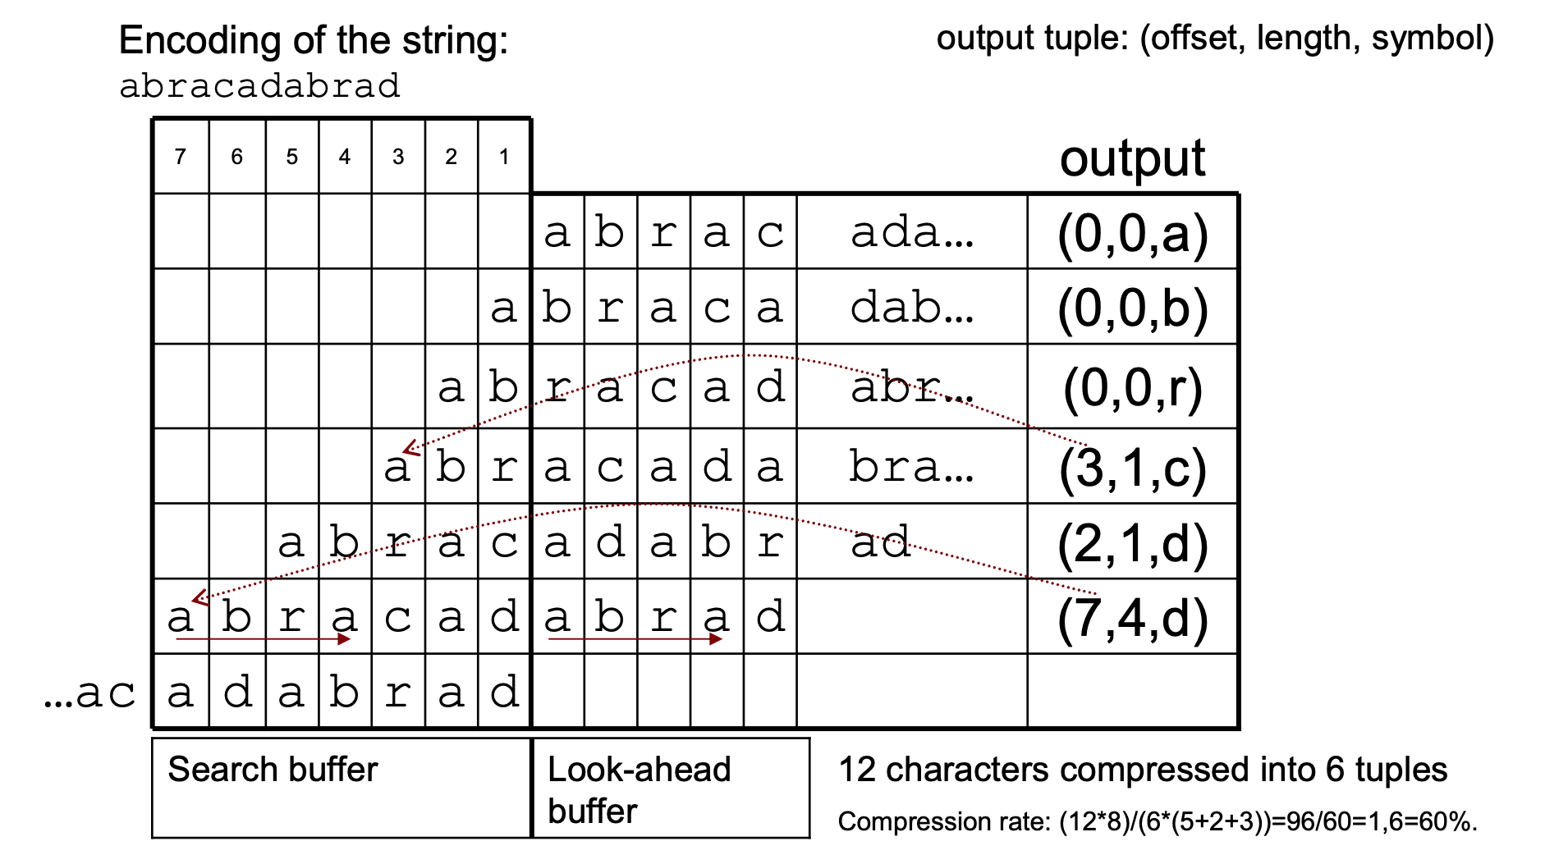
LZ77 visual representation

Slide 9
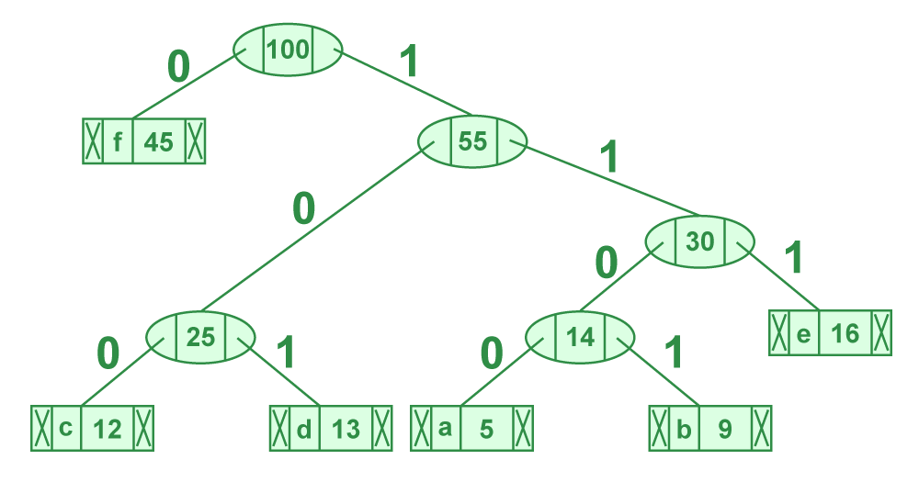
HUFFMAN Tree

Slide 10
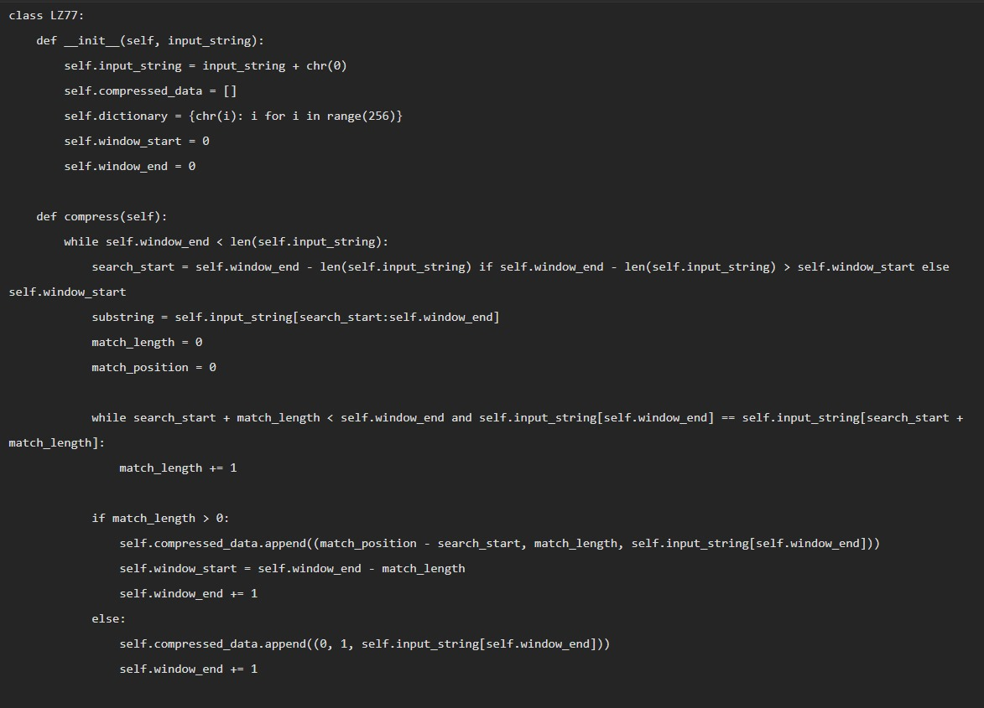

Slide 11
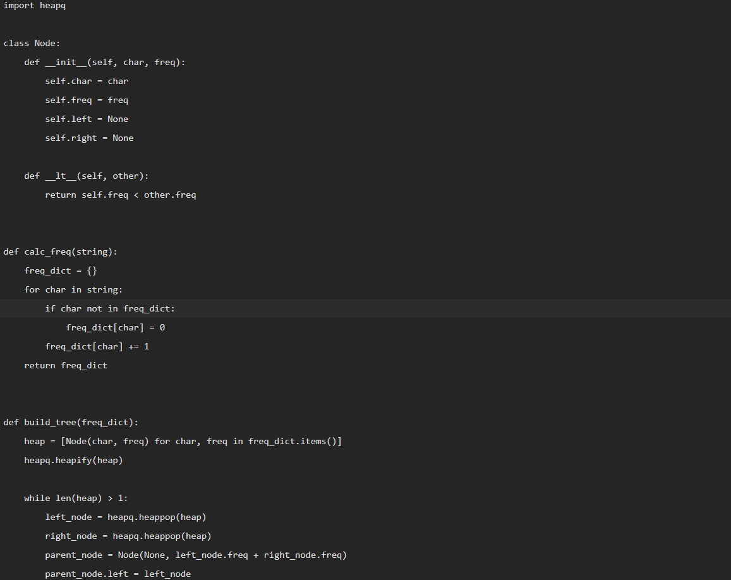

Slide 12
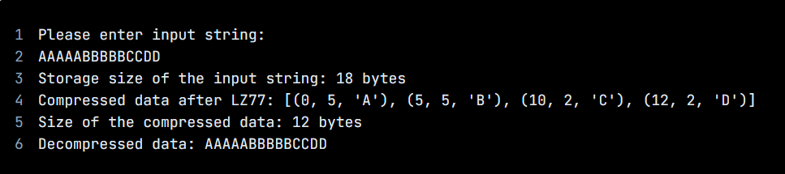

Links to the programs are: Lz77: https://pastebin.com/xQN3zEEd Huffman: https://pastebin.com/zqtR4qqP
Lz77:
Huffman:

Slide 13
CONCLUSION
The DEFLATE algorithm, employed by WhatsApp for text data compression, combines LZ77 compression and Huffman coding.
LZ77 reduces redundancy by identifying and referencing repeated sequences within data, while Huffman coding further minimizes the compressed data's size by optimizing symbol encoding based on frequency.
WhatsApp utilizes DEFLATE to efficiently compress text data, facilitating faster transmission and storage while maintaining information integrity.

Slide 14
THANK YOU

